Slide 1
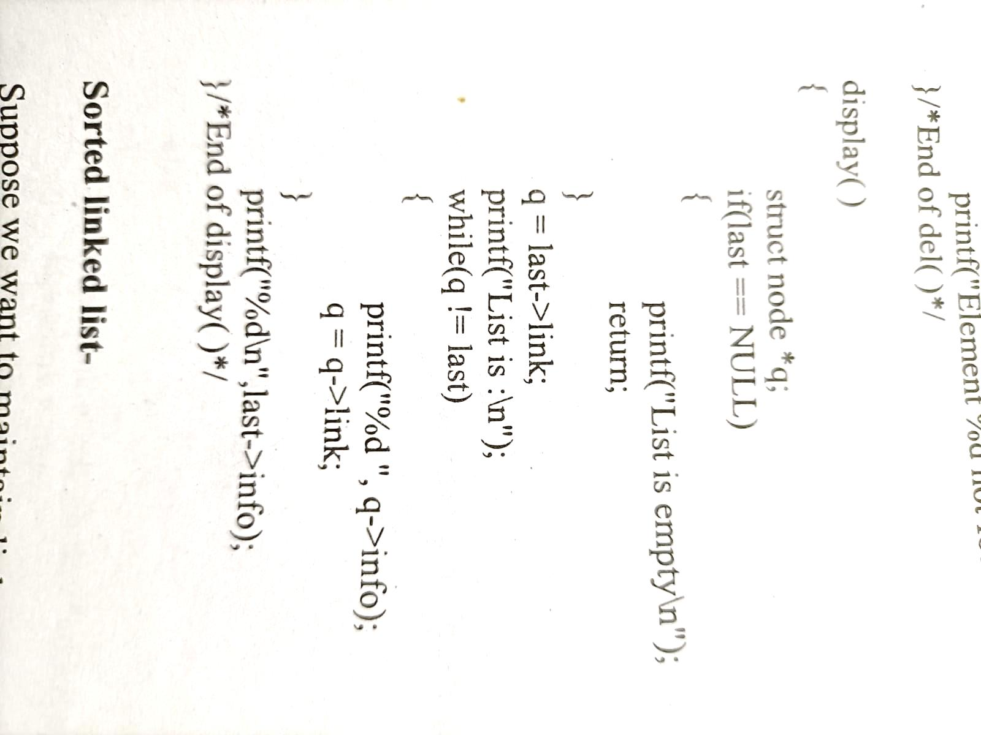
Traversal of circular linked list

Slide 2
Deletion from a circular linked list :-
Deletion in a circular linked list may be possible in four ways-
If list has only one element
Node to be deleted is the first node of list
Deletion in between
Node to be deleted is last node of list

Slide 3
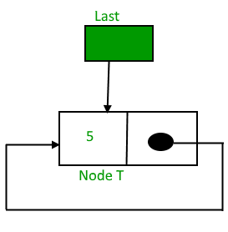
Deletion from a circular linked list :-
Case 1:- If list has only one element
Here we check the condition for only one element of list
then assign NULL value to last pointer because after deletion no node will be in list.
if(last->link == last && last->info == num) /* Only one element */
{
tmp = last;
last = NULL;
free(tmp);
}

Slide 4
Deletion from a circular linked list :-
Case 1:- If list has only one element
Here we check the condition for only one element of list
then assign NULL value to last pointer because after deletion no node will be in list.
if(last->link == last && last->info == num) /* Only one element */
{
tmp = last;
last = NULL;
free(tmp);
}

Slide 5
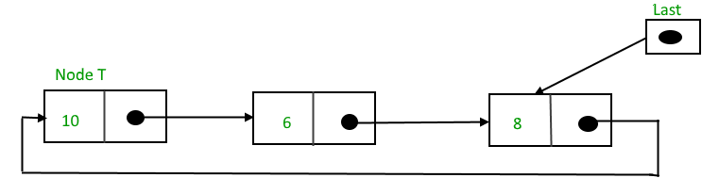
Deletion from a circular linked list :-
Case 2:- Node to be deleted is the first node of list
Assign the link part of deleted node to the link part of pointer last.
So now link part of last pointer will point to the next node which is now first node of list after deletion.
q = last->link; /*q is pointing to the first node of list*/
if(q->info == num)
{
tmp = q;
last->link = q->link;
free(tmp);
}

Slide 6
Deletion from a circular linked list :-
Case 3:- Deletion in between is same as in single linked list.
Deletion of node in between will be as-
q = last->link;
while(q->link != last)
{
if(q->link->info == num) /* Element deleted in between */
{
tmp = q->link;
q->link = tmp->link;
free(tmp);
}
q = q->link;
} /* End of while */
First we are traversing the list, when we find the element to be deleted,
then q points to the previous node.
We assign the link part of node to be deleted to the link part of previous node and
then we free the address of node to be deleted from memory.
As we need to stop at the previous node for deletion

Slide 7
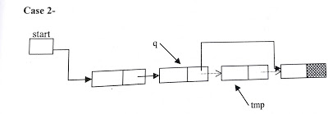
Same as Deletion in between in Singly Linked List
If the element is other than the first element of linked list then
we give the link part of the deleted node to the link part of the previous node.
This can be as-
tmp =q->link;
q->link = tmp->link;
free(tmp);

Slide 8
Deletion from a circular linked list :-
Case 4:- Deletion of last node
Assign the link part of last node to the link part of previous node.
So link part of previous node will point to the first node of list.
Then assign the value of previous node to the pointer variable last because after deletion of last node , pointer variable last should point to the previous node.
tmp = q->link;
q->link = last->link;
free(tmp);
last =q;
q

Slide 9
Doubly Linked List

Slide 10
Doubly Linked List
Drawback of single linked list-
In single linked list,
we can traverse only in one direction because each node has address of next node only.
Suppose we are in the middle of singly linked list and
To do operation with just previous node then we have no way to go on previous node,
We will again traverse from starting node.

Slide 11
Doubly Linked List
Drawback of single linked list-
Solution-
Doubly linked list, in this each node has address of both previous and next node.

Slide 12
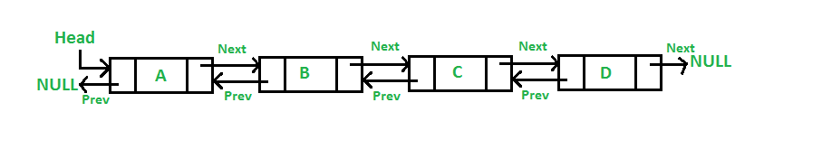
Doubly Linked List

Slide 13
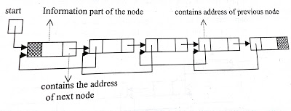
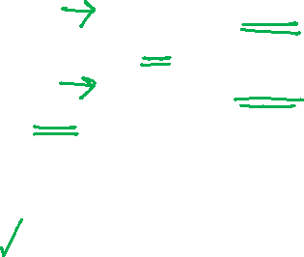
Doubly Linked List
The data structure for doubly linked list will be as-
struct node
{
struct node *prev;
int info;
struct node *next;
}*start;

Slide 14
Doubly Linked List
struct node
{
struct node *prev;
int info;
struct node *next;
}*start;
struct node *previous is a pointer to structure, which will contain the address of previous node
struct node * next will contain the address of next node in the list.
Traversal in both directions at any time.

Slide 15
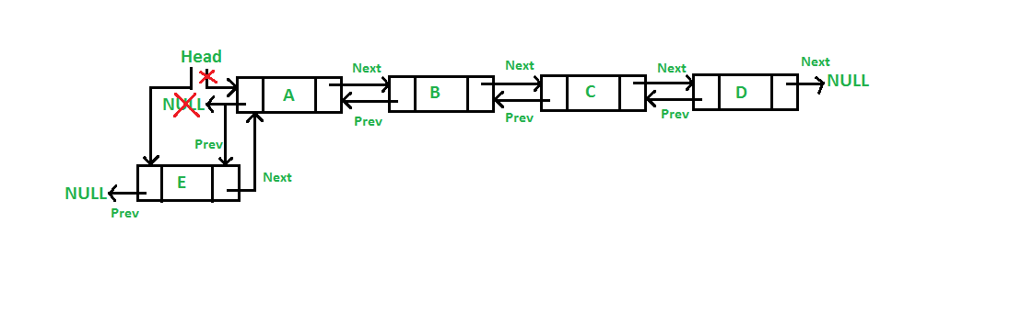
Doubly Linked List-Insertion at beginning
A 5 steps process

Slide 16
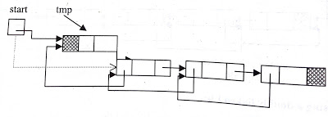
Doubly Linked List-Insertion at beginning
Start points to the first node of doubly linked list.
Assign the value of start to the next part of inserted node and address of inserted node to the prev part of start as-
tmp->next=start;
tmp->info=data
start->prev = tmp;
Now inserted node points to the next node, which was beginning node of the doubly linked list and
prev part of second node will point to the new inserted node. Now inserted node is the first node of the doubly linked list.

Slide 17
Doubly Linked List-Insertion at beginning
So start will be reassigned as-
start= tmp;
Now start will point to the inserted node which is first node of the doubly linked list.
Assign NULL to prev part of inserted node since now it will become the first node and prev part of first node is NULL-
tmp->prev=NULL;

Slide 18
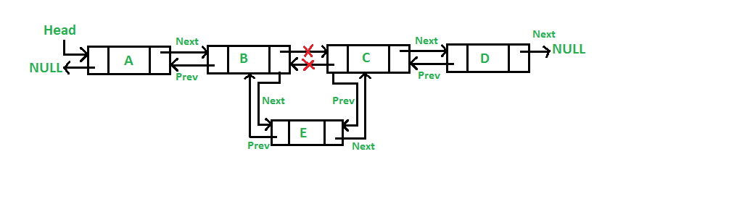
Doubly Linked List-Insertion in between

Slide 19
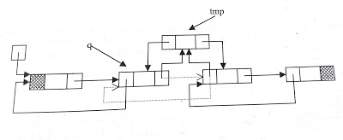
Doubly Linked List-Insertion in between
Traverse to obtain the node (q) after which we want to insert the element.
Assign the address of inserted node(tmp) to the prev part of next node.
q->next->prev=tmp;
1

Slide 20
Doubly Linked List-Insertion in between
Assign the next part of previous node to the next part of inserted node.
tmp->next=q->next;
2
1

Slide 21
Doubly Linked List-Insertion in between
Address of previous node will be assigned to prev part of inserted node
tmp->prev=q;
2
3
1

Slide 22
Doubly Linked List-Insertion in between
Address of inserted node will be assigned to next part of previous node.
q->next=tmp;
2
3
4
1

Slide 23

Doubly Linked List-Insertion in between
Traverse to obtain the node (q) after which we want to insert the element.
Assign the address of inserted node(tmp) to the prev part of next node.
q->next->prev=tmp;
Assign the next part of previous node to the next part of inserted node.
tmp->next=q->next;
Address of previous node will be assigned to prev part of inserted node
tmp->prev=q;
Address of inserted node will be assigned to next part of previous node.
q->next=tmp;

Slide 24
Doubly Linked List-Insertion at the last
Traverse to obtain the node (q) after which we want to insert the element.
tmp->next=NULL;
Address of previous node will be assigned to prev part of inserted node
tmp->prev=q;
q
temp
1
prev |  | next

Slide 25
Doubly Linked List-Insertion at the last
Address of inserted node will be assigned to next part of previous node.
q->next=tmp;
q
temp
1
prev |  | next
2

Slide 26
Deletion from doubly linked list
Traverse the linked list and compare with each element. After finding the element there may be three cases for deletion-
Deletion at beginning
Deletion in between
Deletion of last node

Slide 27
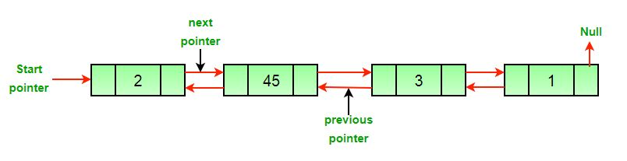
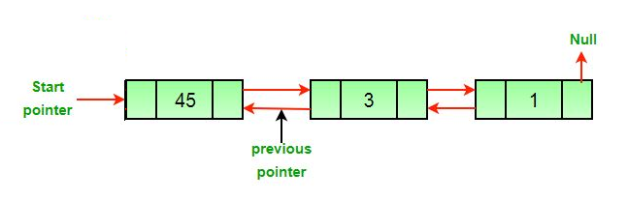
Deletion from doubly linked list-Deletion at beginning

Slide 28
Doubly linked list-Deletion at beginning
Assign the value of start to tmp as-
tmp = start;
Now we assign the next part of deleted node to start as-
start=start->next;
Since start points to the first node of linked list, so start->next will point to the second node of list.
Then NULL will be assigned to start->prev.
start->prev = NULL;
Now we should free the node to be deleted which is pointed by tmp.
free( tmp );

Slide 29
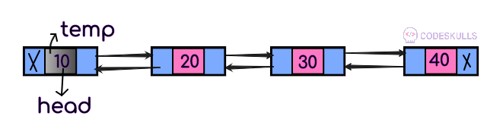
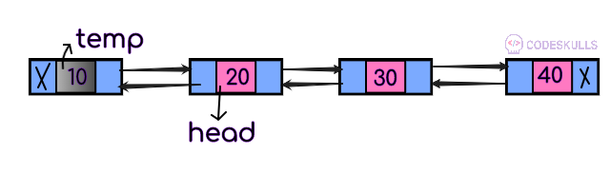
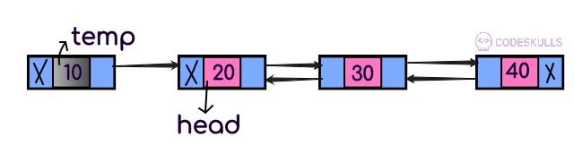
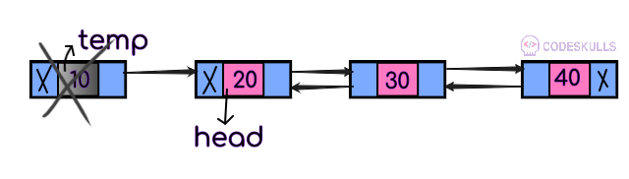
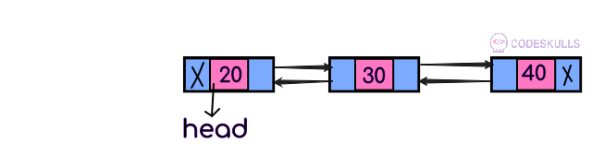
Doubly linked list-Deletion at beginning
1
Assign the value of start to tmp as-
1)tmp = start;

Slide 30
Doubly linked list-Deletion at beginning
1
Now we assign the next part of deleted node to start as-
2)start=start->next;
2

Slide 31
1
Since start points to the first node of linked list, so start->next will point to the second node of list.
Then NULL will be assigned to start->prev.
3)start->prev = NULL;
2
3

Slide 32
Doubly linked list-Deletion at beginning
1
Now we should free the node to be deleted which is pointed by tmp.
4)free( tmp );
2
3
4

Slide 33
Doubly linked list-Deletion at beginning
Assign the value of start to tmp as-
1)tmp = start;
Now we assign the next part of deleted node to start as-
2)start=start->next;
Since start points to the first node of linked list, so start->next will point to the second node of list.
Then NULL will be assigned to start->prev.
3)start->prev = NULL;
Now we should free the node to be deleted which is pointed by tmp.
4)free( tmp );

Slide 34
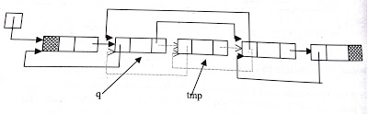

Deletion from doubly linked list-Deletion in between
Concept-
We assign the next part of the deleted node to the next part of the previous node
address of the previous node to prev part of next node.

Slide 35
Deletion from doubly linked list-Deletion in between
tmp=q->next;
Here q is pointing to the previous node of node to be deleted.
After statement 1 tmp will point to the node to be deleted.
1

Slide 36
Deletion from doubly linked list-Deletion in between
tmp=q->next;
q->next=tmp->next;
After statement 2 next part of previous node will point to next node of the node to be deleted
2
1

Slide 37
Deletion from doubly linked list-Deletion in between
tmp=q->next;
q->next=tmp->next;
tmp->next->prev=q;
After statement 3 prev part of next node will point to previous node.
1
3
2
1

Slide 38

Deletion from doubly linked list-Deletion in between
tmp=q->next;
q->next=tmp->next;
tmp->next->prev=q;
free(tmp);
Here q is pointing to the previous node of node to be deleted.
After statement 1 tmp will point to the node to be deleted.
After statement 2 next part of previous node will point to next node of the node to be deleted
After statement 3 prev part of next node will point to previous node.

Slide 39
Doubly linked list-Deletion of last node
Concept-
If node to be deleted is last node of doubly linked list then
we will just free the last node

Slide 40
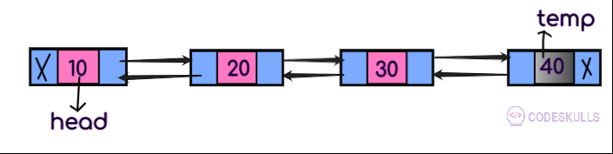
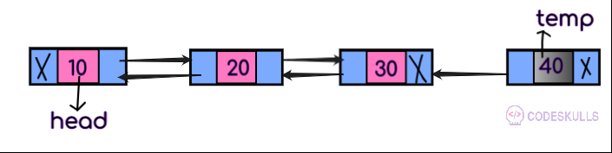
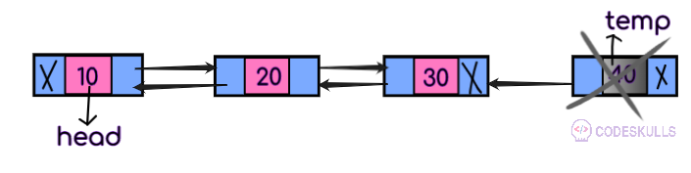
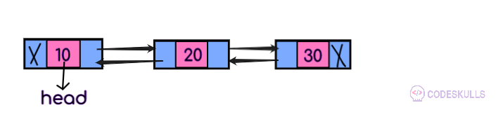


Doubly linked list-Deletion of last node
1
1) tmp=q->next;
Here q is second last node
After statement 1, tmp will point to last node

Slide 41
Doubly linked list-Deletion of last node
1
2) free(tmp);
After statement 2, last node will be deleted
2

Slide 42

Doubly linked list-Deletion of last node
1
Next part of second last node i.e q will be NULL.
3) q->next=NULL;
2
3

Slide 43
Doubly linked list-Deletion of last node
If node to be deleted is last node of doubly linked list then
we will just free the last node and
tmp=q->next;
free(tmp);
next part of second last node will be NULL.
q->next=NULL;
Here q is second last node
After statement 1, tmp will point to last node
After statement 2 last node will be deleted and after statement 3 second last node will become the last node of list.

Slide 44
Application of Linked List
Polynomial Representation and Addition

Slide 45
Polynomial arithmetic with linked list
Linked list can be used
to represent polynomial expression
for arithmetic operations also.

Slide 46
Representation of Polynomial
Let us take a polynomial expression-
5x⁴ + x³ - 6x + 2

Slide 47
Representation of Polynomial
Let us take a polynomial expression-
5x⁴ + x³ - 6x + 2
Here we can see every symbol x is attached with two things,
coefficient
exponent.

Slide 48
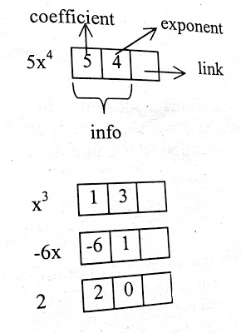

Representation of Polynomial
As in 5x⁴ , coefficient is 5 and exponent is 4.
5x⁴ + x³ - 6x + 2
Each node of list will contain the coefficient and exponent of each term of polynomial expression.

Slide 49

Representation of Polynomial
So the data structure for polynomial expression will be-
struct node{
int coefficient;
int exponent;
struct node *link;
}

Slide 50

Descending sorted linked list is used based on the exponent
As it will be easier for arithmetic operation with polynomial linked list.
Otherwise, we have a need to traverse the full list for every arithmetic operation.

Slide 51

Now we can represent polynomial expression
5x⁴ + x³ - 6x + 2 as-

Slide 52
Creation of polynomial linked list
Creation of polynomial linked list will be same as
creation of sorted linked list but
it be in descending order and based on exponent of symbol.

Slide 53
Creation of polynomial linked list
Insertion at the Start
In if condition we are checking for the node to be added will be first node or not.
/* list empty or exp greater than first one */
if(start==NULL || ex> start->expo)
{
tmp->link=start;
start=tmp;
return start;
}

Slide 54
Creation of polynomial linked list
else
{
ptr=start;
while(ptr->link!=NULL && ptr->link->expo > ex)
{
ptr=ptr->link;
}
tmp->link=ptr->link;
ptr->link=tmp;
if(ptr->link==NULL) /* item to be added in the end */
tmp->link=NULL;
}
In else part
we traverse the list and
check the condition for exponent then
we add the node at proper place in list.
If node will be added at the end of list then
we assign NULL in link part of added node.

Slide 55
Creation of polynomial linked list
Lets insert 9x²
Let ex=2
Ptr=1st Node
Check if ptr->link->expo > ex
Check if 2nd node’s expo >ex
If 3>2, yes
Then
Ptr=ptr->link
Ptr=2nd node
Check if ptr->link->expo>ex
Check if 3rd node’s expo>ex
If 1>2, no
Insert the new node here
9 | 2

Slide 56
Addition with polynomial linked list
Input :
p1= 13x⁸ + 7x⁵ + 32x² + 54
p2= 3x¹² + 17x⁵ + 3x³ + 98
Output : 3x¹² + 13x⁸ + 24x⁵ + 3x³ + 32x² + 152

Slide 57
Addition with polynomial linked list
For addition of two polynomial linked list, we have a need to traverse the nodes of both the lists.
If the node has exponent value higher than another, then
that node will be added to the resultant list
or
Nodes which have unique exponent values in both the lists will be added in the resultant list.

Slide 58
Addition with polynomial linked list
If the nodes have same exponent value then
first the coefficient of both nodes will be added
then the result will be added to the resultant list.

Slide 59
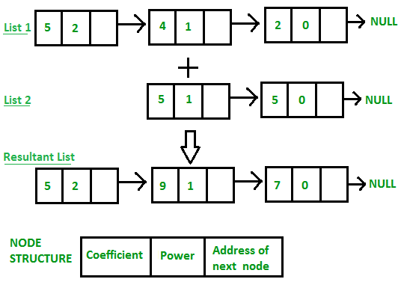
Addition with polynomial linked list
Suppose in traversing one list is finished then
remaining node of the another list will be added to the resultant list.

